Slide 1
ETL PROCESSING ARCHITECTURE
For validating the data from Source to Target

Slide 2
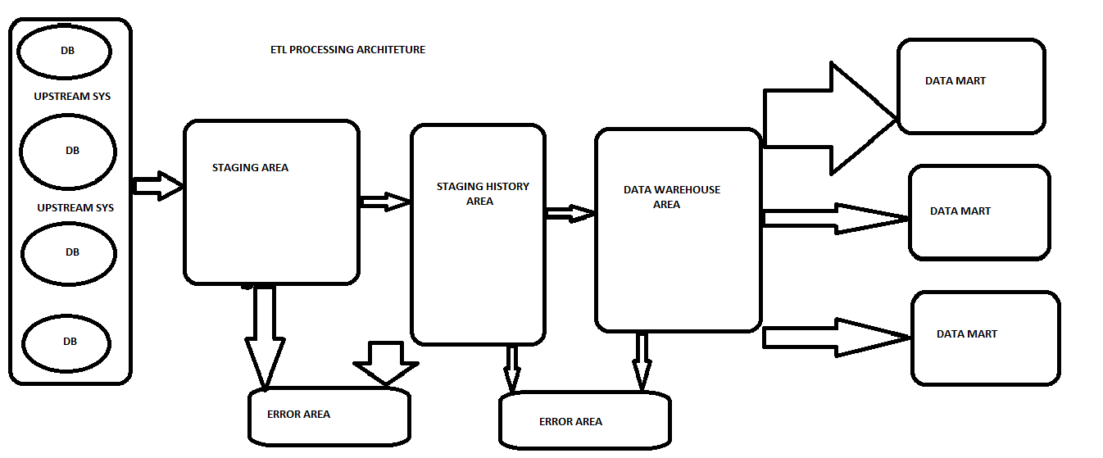
Data Flow Diagram

Slide 3
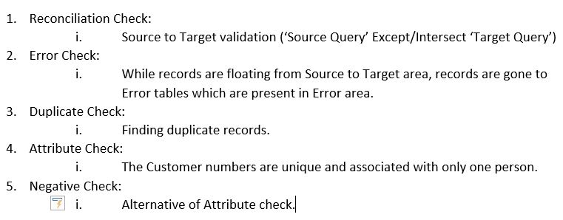
Steps for ETL Testing (Data warehousing)

Slide 4
SQL Queries:
Declare @measurecode varchar(10)
Set @measurecode='CDC10'
(select distinct memid, epop, excl,num,'Expected' as issue from CDC10_Sample_scorekey where meas like '%' +@measurecode+ '%'
Except
select distinct patientid as memid, 1 as epop, case when clinicalstatuscode in (2,3,4,5) then 1 else 0 end as excl, case when clinicalstatuscode = 1 then 1 else 0 end as num, 'Expected' as issue
from factoccurrenceclinicalstatus_currentbatch fact
inner join dimclinicalmeasurelist dcml
on dcml.measureid = fact.measureid
where fact.clinicalstatuscode<=6 And dcml.clinicalmeasureid like ‘%’ +@measurecode+ ’%’
UNION
select distinct patientid as memid,1 as epop, case when clinicalstatuscode in (2,3,4,5) then 1 else 0 end as excl, case when clinicalstatuscode = 1 then 1 else 0 end as num, 'Actual' as issue
from factoccurrenceclinicalstatus_currentbatch fact
inner join dimclinicalmeasurelist dcml
on dcml.measureid = fact.measureid
where fact.clinicalstatuscode <=6 And dcml.clinicalmeasureid like '%' +@measurecode+ '%'
except
select distinct memid, meas, epop, excl,num, 'Actual' as issue from CDC10_Sample_scorekey where meas like '%' +@measurecode+ '%'
)

Slide 5
CLASS ASSIGNMENT
LOGISTIC REGRESSION

Slide 6
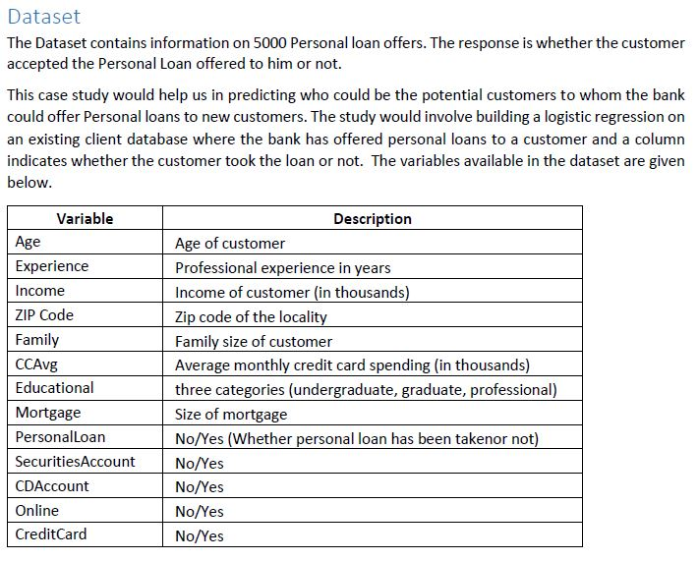
Logistic Regression Practice Data Set & Prob

Slide 7
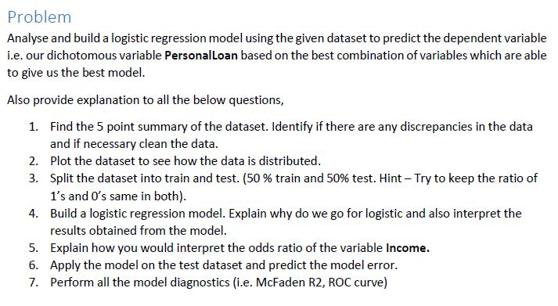
Problem Statement:

Slide 8
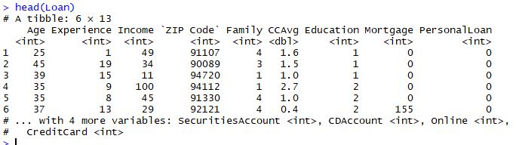
Read the Data Set

Slide 9
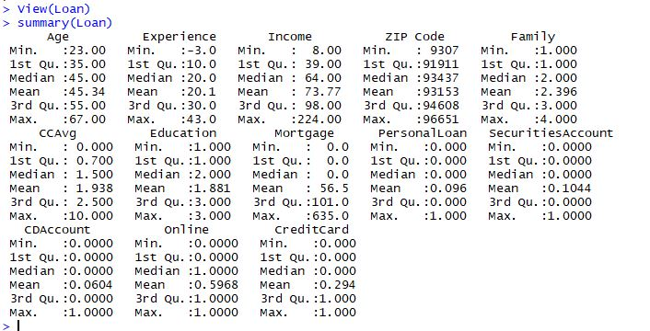
Its always good to look at the summary of the dataset to understand how data is distributed.

Slide 10

From the summary it is clearly understood that the average age of the customers in dataset is 45 years and the min and max age are 23 years and 67 years respectively. If we now look at variable "Experience" we can see that there are some negative values in it. It would not make sense to keep negative values of experience. So we need to remove these data points.

Slide 11
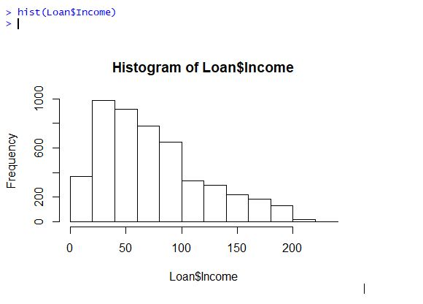
I would now like to plot the Income variable to see how the data is distributed and also check the data is positively skewed or not.

Slide 12
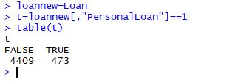
Need to see that a new customer would accept a personal loan or not, we would consider the variable "PersonalLoan" as our dependent variable for our model. we can see that there are 473 customers had accepted personal loan given out of 4882 customers.

Slide 13
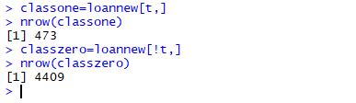
the data is not equally distributed between ‘classone’ and ‘classzero’ i.e. there are more customers who have not taken a personal loan compared to the customers who took the personal loan. Since we would like to have unbiased results for our model we need to split the data in such a way that the ratio of 0 and 1 remains same in train and test dataset as it was in our original dataset.

Slide 14
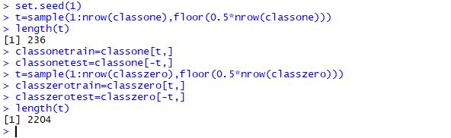
Now I would like to split the dataset to Train and Test. The Train dataset would be used to build the model and the Test would be used to validate how well my model is performing. The Train and Test dataset are created using the "sample" function. Since the sample function generates a random selection every time it is executed, I would like to use "set.seed" function so that sample generated remains same every time if I run the code. This would help us in having consistent results. I split the classone and classzero dataset to train and test respectively.

Slide 15
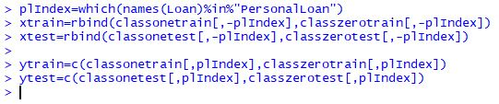
Now I create the train and test dataset for the independent and dependent variables. xtrain & xtest would be the split for independent variables and ytrain & ytest would be the split for dependent variable i.e. Personal Loan.

Slide 16
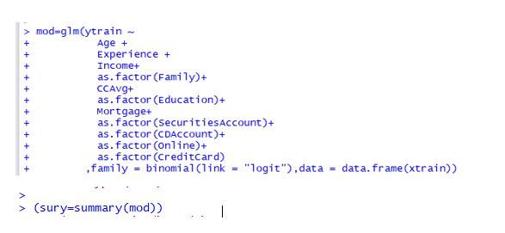
Now ready to build a model. For performing logistic I would like to use the ‘glm’ function with family="binomial". I would like to consider all the categorical variables as factor variables.

